Slide 1
Dynamic Programming

Slide 2
Coin Change
Given an integer array of coins[ ] of size N representing different types of currency and an integer sum, The task is to find the number of ways to make sum by using different combinations from coins[].
Note: Assume that you have an infinite supply of each type of coin, and you are allowed to use same valued multiple times.

Slide 3
Coin Change
Input: sum = 4, coins[] = {1,2,3}, n =3 Output: 4 Explanation: there are four solutions:
{1, 1, 1, 1}, {1, 1, 2}, {2, 2}, {1, 3}.
Input: sum = 10, coins[] = {2, 5, 3, 6}, n =4 Output: 5 Explanation: There are five solutions:
{2,2,2,2,2}, {2,2,3,3}, {2,2,6}, {2,3,5} and {5,5}.

Slide 4
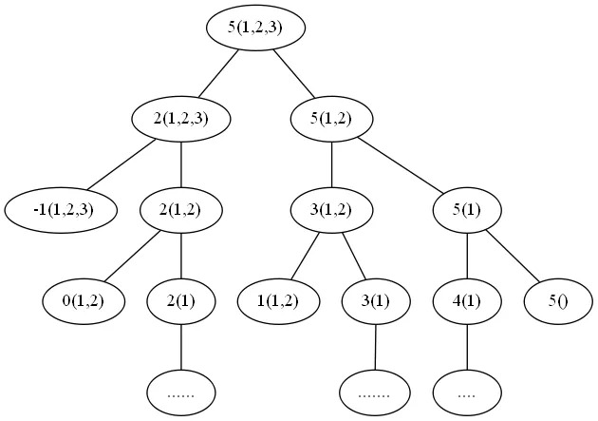
Coin Change

Slide 5
Coin Change
Smaller sub problems:
change(sum,n) = change(sum, n-1) + change(sum - coins[n],n)

Slide 6
Coin Change Bottom-Up (Tabulation)
Sum = 0
Sum = 1
Sum = 2
… …
Sum = S
0 coin
1 coins
2 coins
…
…
n coins

Slide 7
Coin Change Bottom-Up (Tabulation)
Sum = 0
Sum = 1
Sum = 2
… …
Sum = S
0 coin
1 | 0 | 0 | 0 | 0 | 0 | 0 | 0
1
1
1
1
1
1
1
1 coins
2 coins
…
…
n coins

Slide 8
Bottom up implementation 1
for (i = 0; i <= n; i++)
dp[i][0] = 1;
for (j = 1; i <= sum; i++)
dp[0][j] = 0;
for (i = 1; i <= n ; i++) {
for (j = 1; j <= sum; j++) {
if(j < coins[i - 1]) //0 indexed coins array
dp[i][j] = dp[i-1][j];
else
dp[i][j] = dp[i-1][j] + dp[i] [ j – coins[i - 1] ];
}
}
return dp[n][sum];

Slide 9
Coin Change Bottom-Up (2)
Sum = 0
Sum = 1
Sum = 2
… …
Sum = S
0 coin
1 | 0 | 0 | 0 | 0 | 0 | 0 | 0
0 | 0 | 0 | 0 | 0 | 0 | 0 | 0
0 | 0 | 0 | 0 | 0 | 0 | 0 | 0
0 | 0 | 0 | 0 | 0 | 0 | 0 | 0
0 | 0 | 0 | 0 | 0 | 0 | 0 | 0
0 | 0 | 0 | 0 | 0 | 0 | 0 | 0
0 | 0 | 0 | 0 | 0 | 0 | 0 | 0
0 | 0 | 0 | 0 | 0 | 0 | 0 | 0
1 coins
2 coins
…
…
n coins

Slide 10
Bottom up implementation (2)
dp[0][0] = 1;
for (i = 1; i <= n ; i++) {
for (j = 0; j <= sum; j++) {
if(j < coins[i - 1]) //0 indexed coins array
dp[i][j] = dp[i-1][j];
else
dp[i][j] = dp[i-1][j] + dp[i] [ j – coins[i - 1] ];
}
}
return dp[n][sum];

Slide 11
Top down solution?

Slide 12
Top down solution (Recursive)
Initialize the dp array as -1 //to check whether the value is updated or not
f(n, sum)
Base Cases:
if(sum == 0) return dp[sum][n] = 1;
else if(n == 0) return dp[sum][n] = 0;
else if(dp[n][sum] != -1) return dp[n][sum];
else recursive call

Slide 13
Coin Change (Variations)
Can only use each coins only once
Each coins has limited supply (Can be different for each coin type)
Only allowed to use k coins (all together)

Slide 14
Coin Change (Minimum Number of coins)
Your goal is to find the minimum number of coins required, to give an exchange of a target (sum) by using n coins having values:
coins[] = {c1, c2, c3….cn}

Slide 15
Recurrence Relation
Smaller sub problems and the relation between them ?

Slide 16
Recurrence Relation
< Excluding n^{th} coins and including n^{th} coins>
Eexcluding:
dp[n-1][sum]
Including:
1 + dp[n] [ sum – coins[n] ]
Relation between them?

Slide 17
Coin Change (Minimum Number of coins)
< Excluding n^{th} coins and including n^{th} coins>
Eexcluding:
dp[n-1][sum]
Including:
1 + dp[n] [ sum – coins[n] ]
min (excluding, including)

Slide 18
Coin Change (Minimum number of coins)
Sum = 0
Sum = 1
Sum = 2
… …
Sum = S
0 coin
1 coins
2 coins
…
…
n coins

Slide 19
Coin Change (Minimum number of coins)
Sum = 0
Sum = 1
Sum = 2
… …
Sum = S
0 coin
0
0
0
0
0
0
0
0
1 coins
2 coins
…
…
n coins

Slide 20
Coin Change (Minimum number of coins)
Sum = 0
Sum = 1
Sum = 2
… …
Sum = S
0 coin
0 | ∞ | ∞ | ∞ | ∞ | ∞ | ∞ | ∞
0
0
0
0
0
0
0
1 coins
2 coins
…
…
n coins

Slide 21
Bottom up implementation 1
for (i = 0; i <= n ; i++) {
for (j = 0; j <= sum; j++) {
if(j==0) dp[i][j] = 0; //Can be initialized outside loop
else if(i==0) dp[i][j] = INF; //Can be initialized outside loop
else if(j < coins[i - 1])
dp[i][j] = dp[i-1][j];
else
dp[i][j] = min( dp[i-1][j], 1 +dp[i] [ j – coins[i - 1] ] );
}
}

Slide 22
Knapsack Problem [0-1]
Given weights and values of N items, put these items in a knapsack of capacity W to get the maximum total value in the knapsack.

Slide 23
Knapsack Problem [0-1]
Input: N = 3, W = 4
values[] = {1,2,3}
weight[] = {4,5,1}
Output: 3
Input: N = 3, W = 3
values[] = {1,2,3}
weight[] = {4,5,6}
Output: 0

Slide 24
Recurrence Relation
Smaller sub problems and the relation between them ?

Slide 25
Recurrence Relation
Smaller sub problems and the relation between them ?
dp[i][w] = max(val[i] + dp[i - 1][w - wt[i ]], dp[i - 1][w]);

Slide 26
Knapsack Problem [0-1]
W = 0
W = 1
W = 2
… …
W = S
0 obj
1 obj
2 obj
…
…
n obj

Slide 27
Knapsack Problem [0-1]
w = 0
w = 1
w = 2
… …
w = W
0 obj
0 | 0 | 0 | 0 | 0 | 0 | 0 | 0
0
0
0
0
0
0
0
1 obj
2 obj
…
…
n obj

Slide 28
Knapsack Problem Variations
Each object has unlimited supply
You may take a fraction of a object

